Slide 1
Module 5
Industry Analysis and Competitive Advantage
By: Dr Shahinaz Abdellatif

Slide 2
What’s a market?
A group of individuals or organizations (i.e., buyers) having the willingness and ability to buy goods or services to satisfy a particular class of wants or needs.

Slide 3
What’s an industry?
A group of organizations (i.e., sellers) offering goods or services that are similar and close substitutes for one another

Slide 4
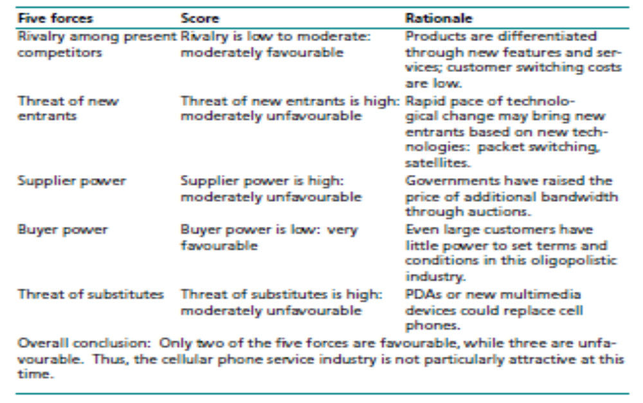
Major Forces That Determine Industry Competition

Slide 5
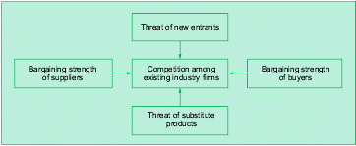
Major Forces That Determine Industry Competition

Slide 6
Major Forces That Determine Industry Competition

Slide 7
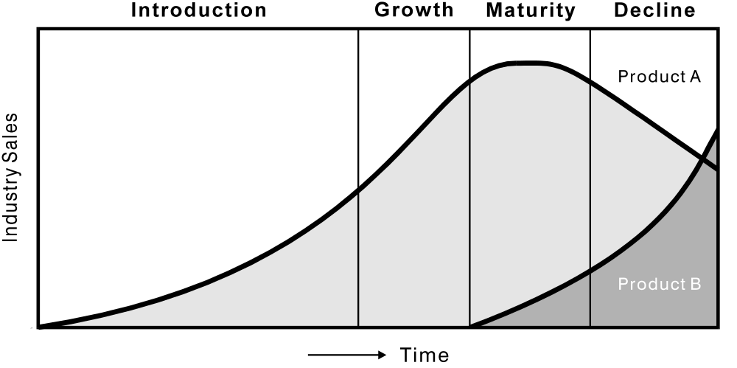
The Product Life Cycle

Slide 8
Market Evolution
“diffusion of innovation” theory seeks to explain the adoption of a product or service over time among a group of potential buyers.
Lack of awareness and limited distribution typically limit early adoption. As positive word about the product spreads, the product is adopted by additional consumers.
Diffusion theory is useful to managers in predicting the likely adoption rate for new and innovative goods or services.
It underlies the PLC

Slide 9
Market Evolution
The Adoption Process involves the attitudinal changes experienced by individuals from the time they first hear about a new product, service, or idea until they adopt it
Not all individuals respond alike; some tend to adopt early, some late, and some never.
The five stages in the adoption process are awareness, interest, evaluation, trial, and adoption:

Slide 10
Adoption Stages
1. Awareness. In this stage, the person is only aware of the existence of the new product and is insufficiently motivated to seek information about it.
2. Interest. the individual becomes sufficiently interested in the new product but is not yet involved.
3. Evaluation. This is sometimes referred to as the mental rehearsal stage. At this point, the individual is mentally applying the new product to his or her own use requirements and anticipating the results.

Slide 11
Adoption stages
4. Trial. the individual actually uses the product, but, if possible, on a limited basis to minimise risk. Trial is not tantamount to adoption; only if the use experience is satisfactory will the product stand a chance of being adopted.
5. Adoption. In this stage, the individual not only continues to use the new product but also adopts it in lieu of substitutes.

Slide 12
Types of adopters
Innovators represent the first 2.5 per cent of all individuals who ultimately adopt a new product. They are more venturesome than later adopters, more likely to be receptive to new ideas and tend to have high incomes, which reduces the risk of a loss arising from an early adoption.
Early adopters represent the next 13 to 14 per cent who adopt. They are more a part of the local scene, are often opinion leaders, serve as vital links to members of the early majority group (because of their social proximity) and participate more in community organisations than do later adopters.

Slide 13
The early majority includes 34 per cent of those who adopt. These individuals display less leadership than early adopters, tend to be active in community affairs (thereby gaining respect from their peers), do not like to take risks and want to be sure that a new product will prove successful before they adopt it.
The late majority represents another 34 per cent. Frequently, these individuals adopt a new product because they are forced to do so for either economic or social reasons. They participate in community activities less than the previous groups and only rarely assume a leadership role.

Slide 14
Laggards comprise the last 16 per cent of adopters. Of all the adopters, they are the most ‘local’. They participate less in community matters than members of the other groups and stubbornly resist change. In some cases, they adopt a product so late that it has already been replaced by another new product.

Slide 15
Speed of adoption process
The speed of the adoption process depends on the following factors:
the risk (cost of product failure or dissatisfaction);
the relative advantage over other products;
the relative simplicity of the new product;
Compatibility with previously adopted ideas;
the extent to which its trial can be accomplished on a small-scale basis; and
the ease with which the central idea of the new product can be communicated.

Slide 16
